Slide 1
Transforming and Analyzing Data with SQL
By: Sarah Kasim

Slide 2
Project Goals
Import data using SQL
Data cleaning
Data analysis and Querying
Identify Patterns and Summarize
Provide actionable insights
Support decision making

Slide 3

CHALLENGES:

Slide 4
Importing the data
Ensuring the correct data types were used.
Altering data types

Slide 5
2. Cleaning the Data
There were a lot of empty columns in the table, “all_sessions”., To ensure the integrity of the date, some columns were dropped and a view was created.

Slide 6
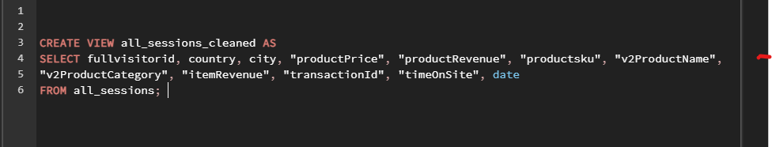
Creating Views:
CcCeta

Slide 7



What could the data tell us?

Slide 8
Does the time on site correlate with the revenue or the amount of products being purchased?
Which products generate the highest revenue?
Is there a correlation between the number of transactions and the time of day?
Is there a pattern in visitor behaviour based on their location?
Is there a relationship between the time spent on site and the likelihood of making a purchase? If so, what’s the average?
How do different product categories perform in terms of revenue and visitor interaction data?

Slide 9
QA process
04
Asking the right questions.
How do we improve data collection from a front end perspective?
L
01
03
Using queries to clean and validate the data.
Identifying issues that arise and propose solutions to solve them
02

Slide 10

What would you do if you had more time?

Slide 11
Explore the data more.
Find out why certain columns exist
What could they mean? Could they provide more information?
Can we predict future trends based on the data?

Slide 12

Thank you!

